Slide 1
Prediction of π-turns in Proteins Using PSI-BLAST Profiles and Secondary Structure Information
Yan Wang, Zhi-Dong Xue, Xiao-Hong Shi, Jin Xu
Department of Control Science and Engineering, Huazhong University of Science and Technology, Wuhan City 430074, China
Software College, Huaazhong University of Science and Technology, Wuhan City 430074, China
Biochemical and Biophysical Research Communications 347 (2006) 574-580
Presenter : Hsin-Wei Yen
Date : July 30, 2008

Slide 2
Abstract (1/3)
Due to the structural and functional importance of tight turns, some methods have been proposed to predict γ-turns, β-turns, and α-turns in proteins. In the past, studies of π-turns were made, but not a single prediction approach has been developed so far. It will be useful to develop a method for identifying π-turns in a protein sequence.

Slide 3
Abstract (2/3)
In this paper, the support vector machine (SVM) method has been introduced to predict π-turns from the amino acid sequence. The training and testing of this approach is performed with a newly collected data set of 640 non-homologous protein chains containing 1931 π-turns.

Slide 4
Abstract (3/3)
Different sequence encoding schemes have been explored in order to investigate their effects on the prediction performance. With multiple sequence alignment and predicted secondary structure, the final SVM model yields a Matthews correlation coefficient (MMC) of 0.556 by a 7-fold cross-validation.

Slide 5
π-turn
The polypeptides containing 6 residues and having a hydrogen bond between residue i and residue i+5
The π-helix (consecutive π-turn) were excluded

Slide 6
Materials
Data set was selected from the pdbselect of October 2005 with a sequence homology <25%
640 proteins including 1931 π-turns and 124,352 residues
π-turn in the data set is 9.3%
On average, there are 3 π-turns in each protein

Slide 7
Encoding Schemes
Single sequence
Multiple sequence alignment in the form of PSSMs
Single sequence + predicted secondary structure by PSIPRED
Multiple sequencse alignment + predicted secondary structure by PSIPRED
Multiple sequencse alignment + observed secondary stucture assigned by DSSP

Slide 8
Single Sequence
Each residue is encoded as a vector of 20 binary elements of a single one and 19 zeros
The N-terminus and the C-terminus, a “null” residue represented by a 20-zero vector is used
[ ……00000100000000000000… ]

Slide 9
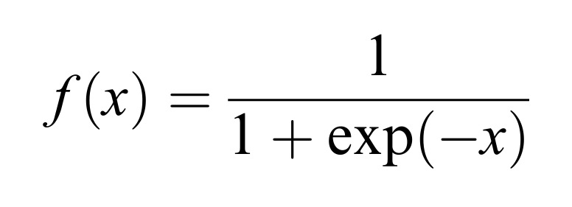
PSSM
The profile matrix elements are scales to 0-1 range by the standard logistic function:

Slide 10
PSIPRED
Position Specific Iterated PRED
Secondary structure information predicted by PSIPRED is encoded as follows:
helix -> [1, 0, 0]
strand -> [0, 1, 0]
coil -> [0, 0, 1]

Slide 11
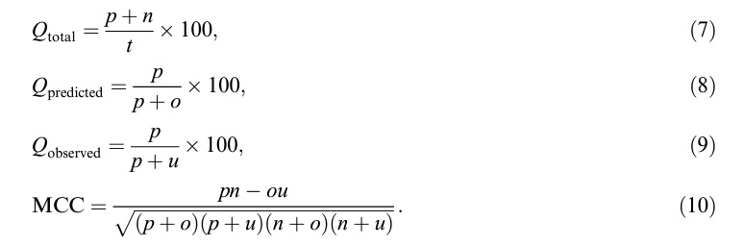
Performance Measures

Slide 12
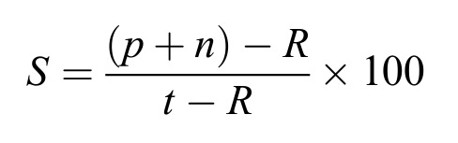
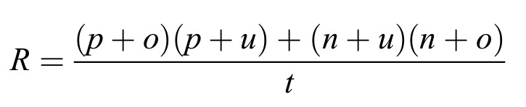
Performance Measures (cont’)

Slide 13
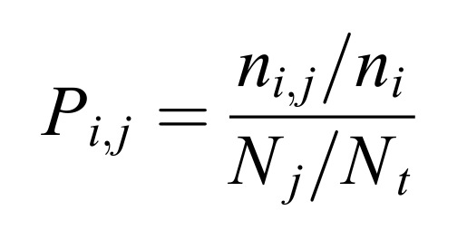
Positional Potentials
n_{i,j} : residue i which occurs at position j
n_{i} : residue i in all the 640 proteins
N_{j} : residues in position j
N_{t} : total number of residues

Slide 14
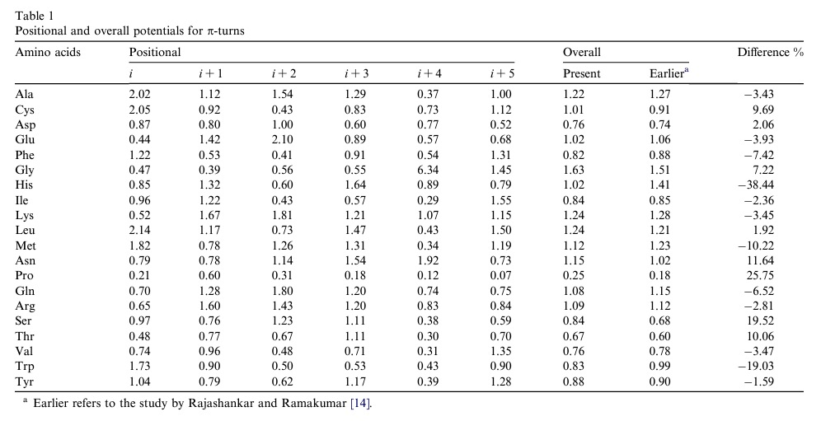
Positional Potentials (cont’)

Slide 15
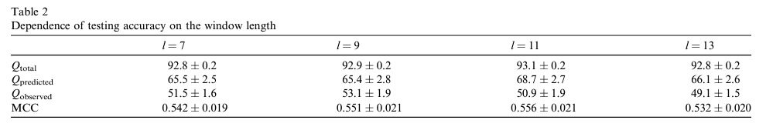
Windows Size Optimization

Slide 16
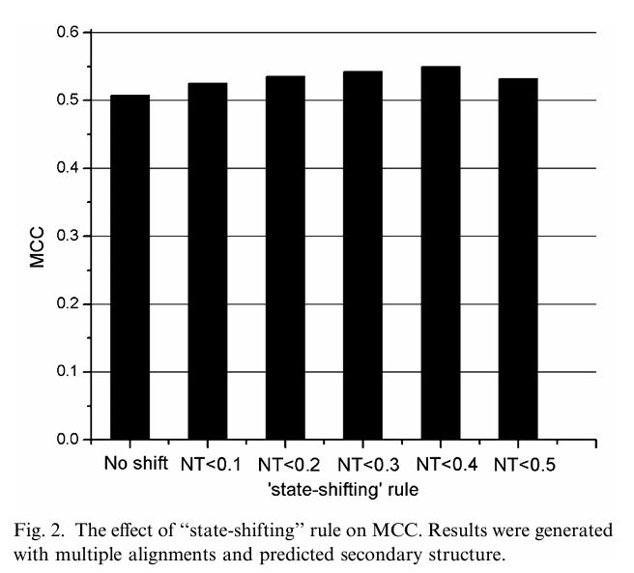
State-Shifting

Slide 17
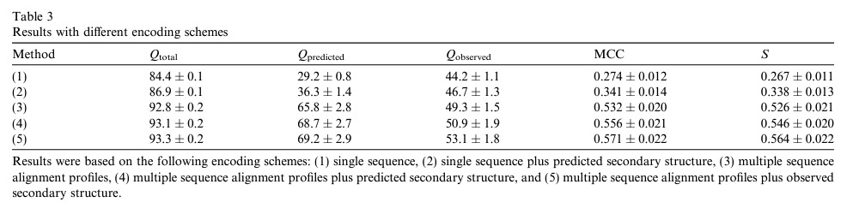
Results

